Slide 1


New Plants Diseases Project
Team Members :
Ahmed Nasser Emam Ibrahim (Section 1)
Amgad Mohamed Salem Tayel (Section 2)
Asem Saber Mohamed Iraqi (Section 3)
Abdelrahman Ayman Dessoky (Section 3)
Abdelrahman Mohamed Ali Dessoky Badr (Section 4)
Supervised by :
Dr. / Ibrahim Zaghloul
Eng. / Sara Abd-Elmohsen

Slide 2

Introduction
In This Project we make a classify for New Plants diseases Using CNN model
Plant diseases can have a devastating impact on agriculture and food production.
Early detection and accurate diagnosis are crucial in effectively managing plant diseases and preventing significant crop losses.
we will explore a cutting-edge approach to plant disease identification using Convolutional Neural Networks (CNNs)
Photo by Pexels

Slide 3
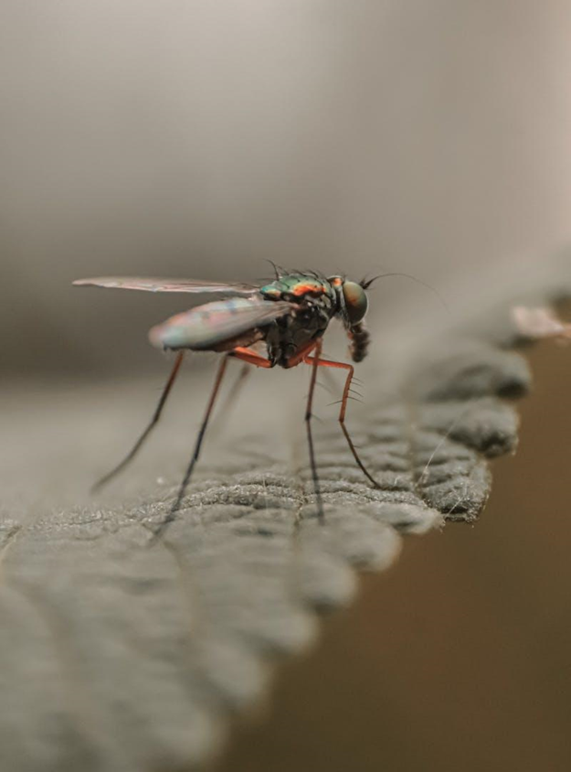
Introduction
CNNs have emerged as powerful tools in image classification and have shown great potential in accurately identifying plant diseases
By leveraging CNNs, we can process large amounts of data quickly and potentially achieve real-time disease detection..
Our focus will be on presenting our work on the development and performance of a CNN model for plant disease identification.
Photo by Pexels

Slide 4
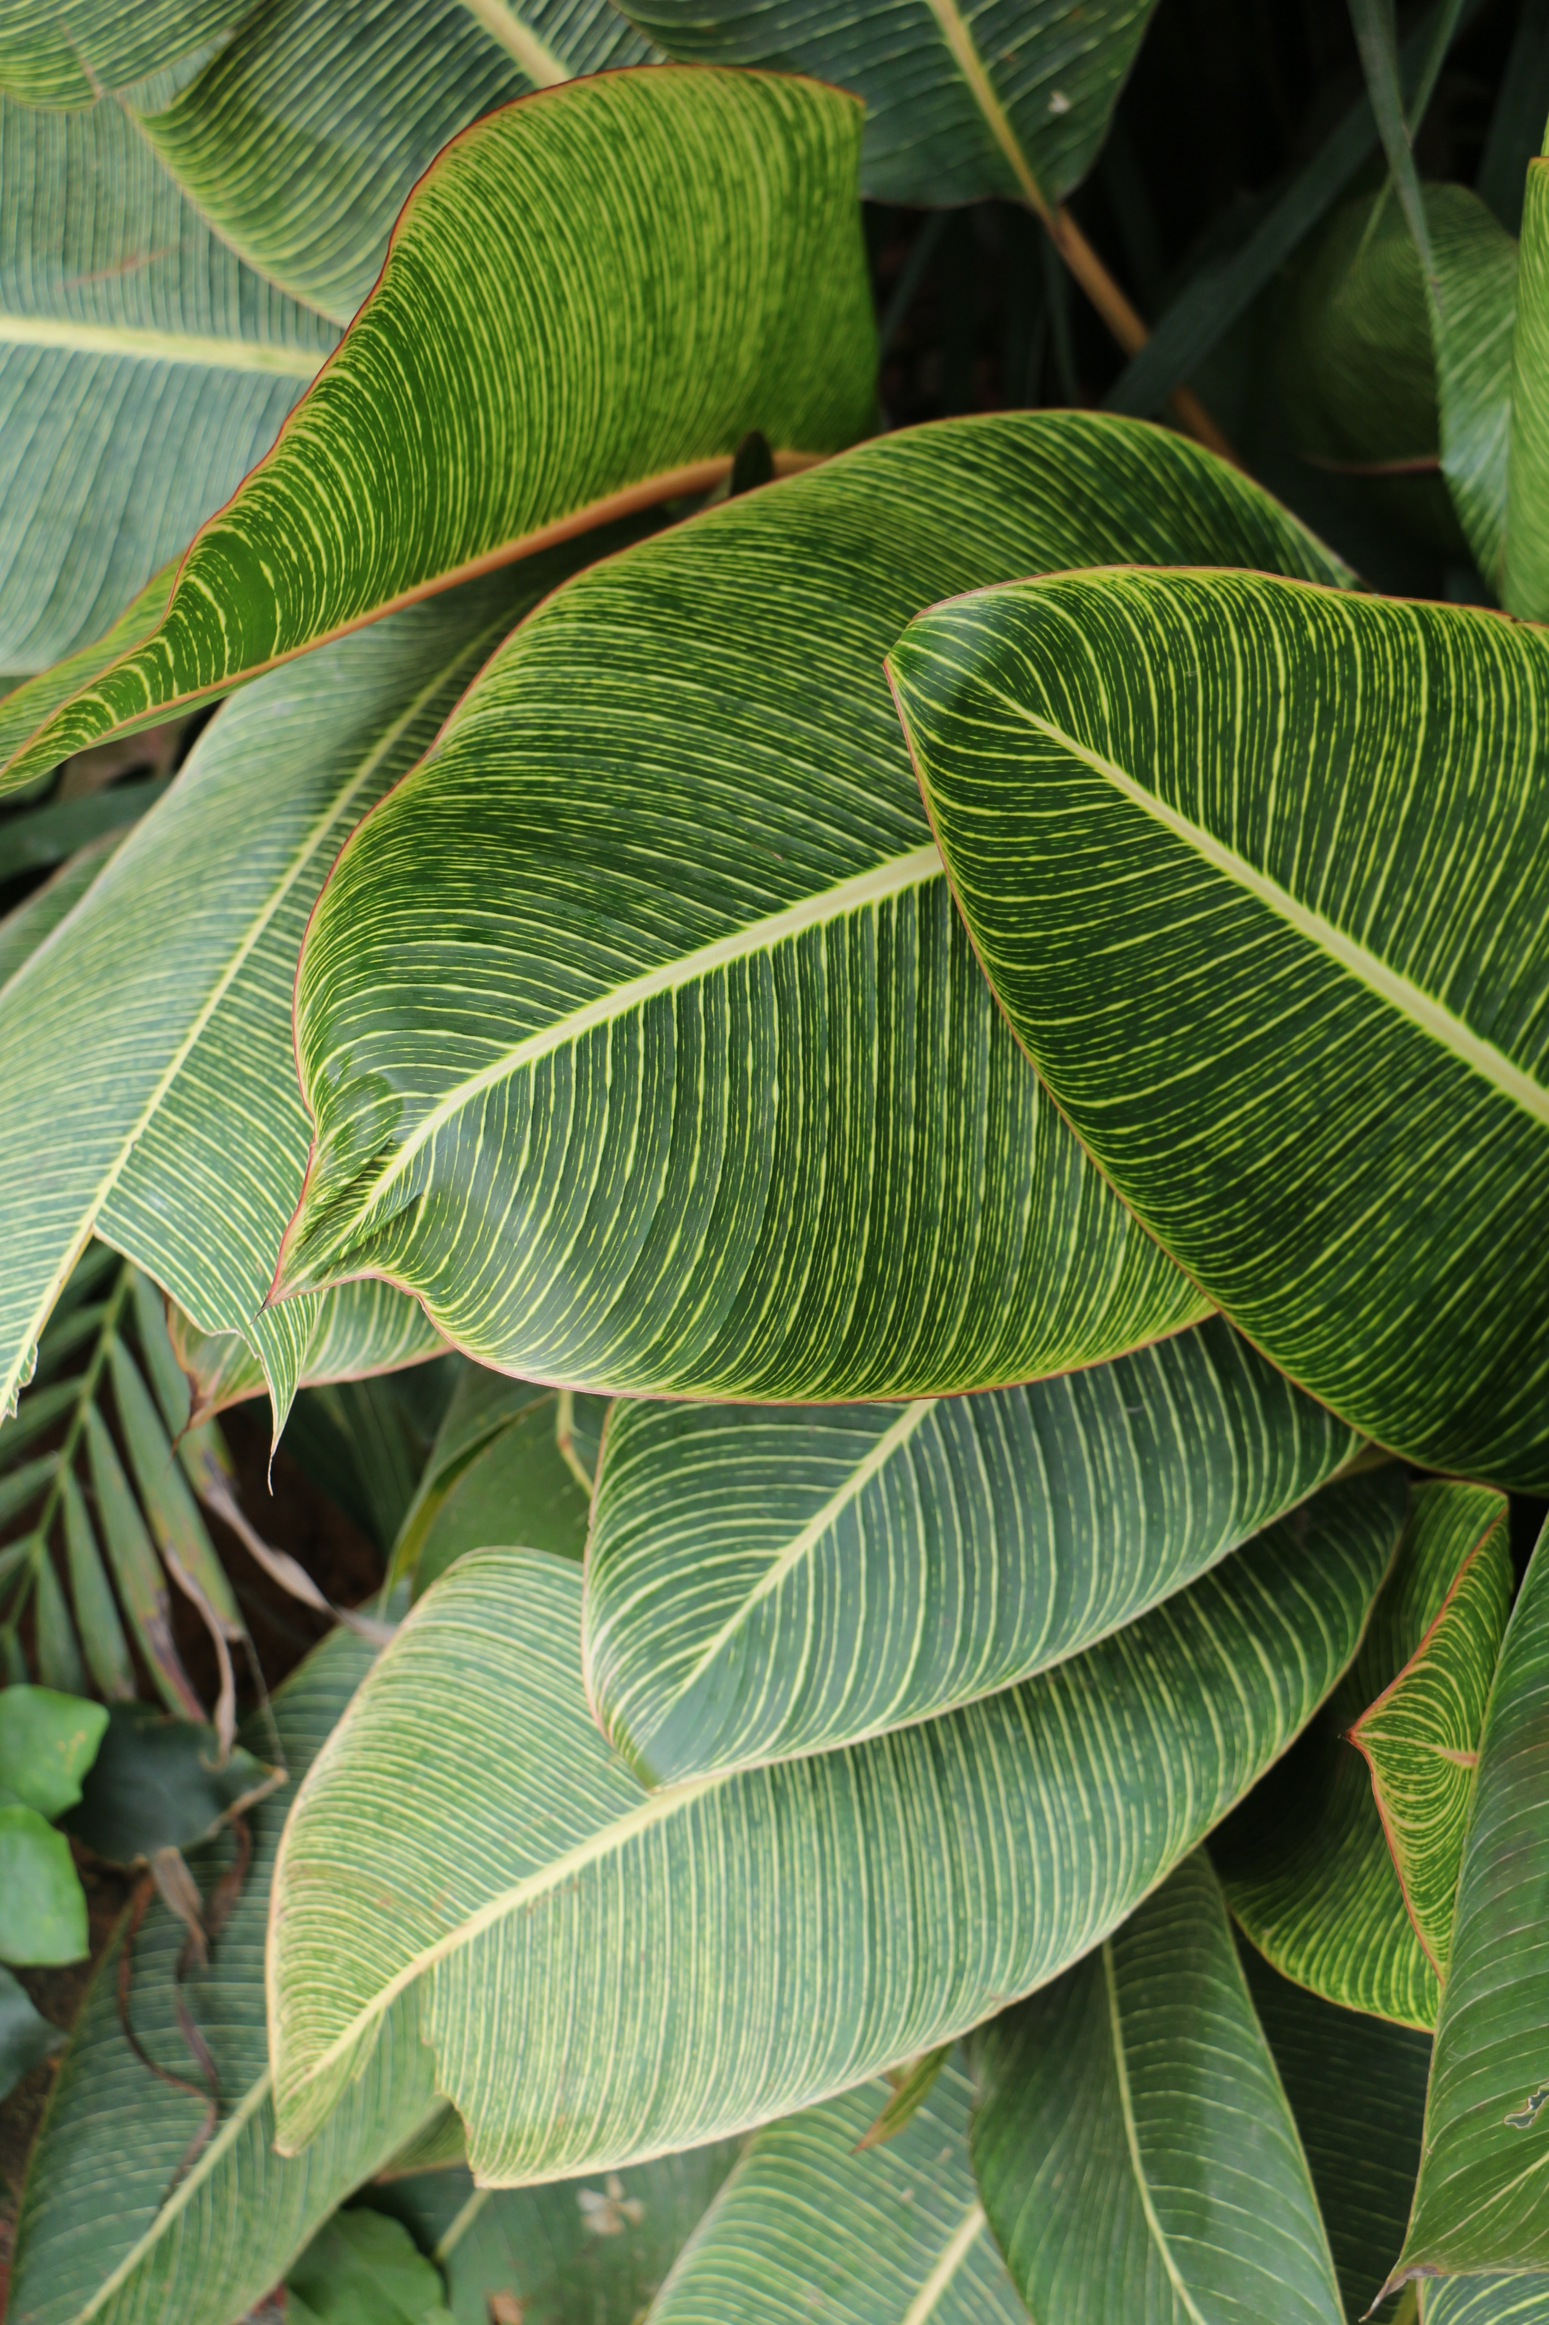
Objective of this project :
The primary objective of our project is to develop and deploy an accurate and efficient plant disease identification system using Convolutional Neural Networks (CNNs).
Our aim is to provide a reliable and automated solution for early detection and diagnosis of plant diseases, enabling prompt interventions and mitigating crop losses.
By leveraging the power of CNNs, we seek to improve the speed and accuracy of plant disease identification compared to traditional manual methods.
Photo by Pexels

Slide 5
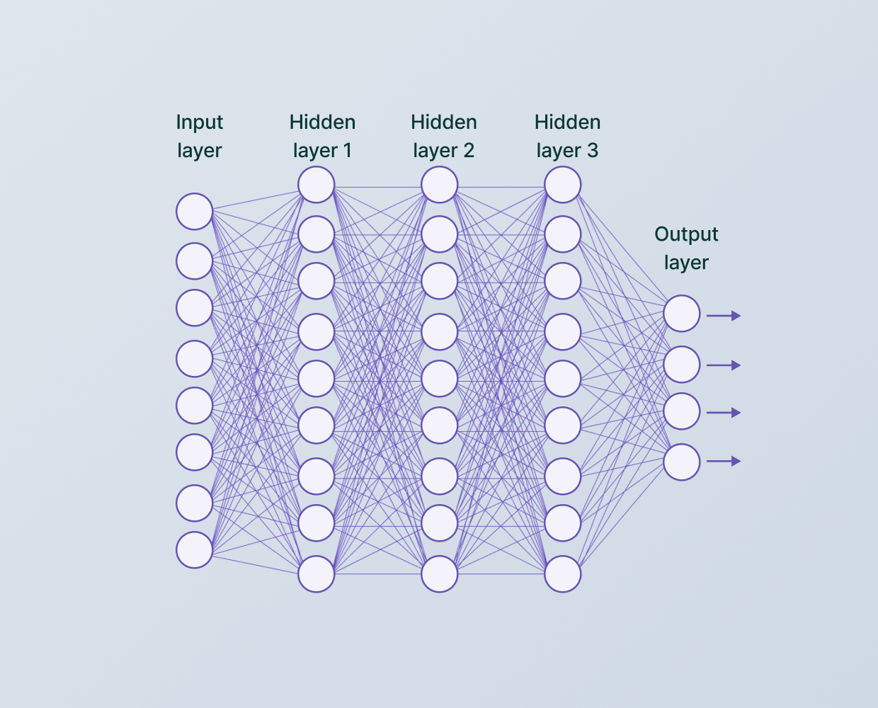
Overview of Convolution Neural Network CNN
Convolutional Neural Networks (CNNs) are a class of deep learning algorithms widely used for image classification tasks.
The architecture of CNNs consists of multiple layers, including convolutional layers, pooling layers, and fully connected layers.
Convolutional layers extract local patterns or features from input images through convolution operations.
Pooling layers down sample the feature maps, reducing spatial dimensions while retaining important information.
Photo by Pexels

Slide 6
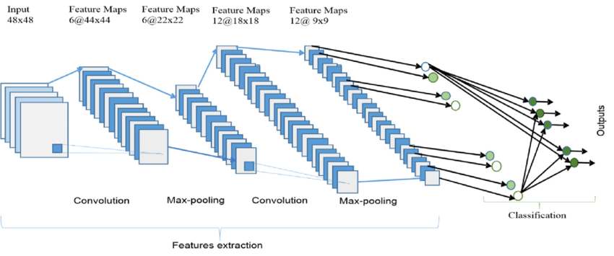
Why We Use CNN In This Project?
The ability of CNNs to learn complex patterns and generalize from limited data makes them valuable tools in automated disease diagnosis.
CNNs have demonstrated remarkable performance in various domains, including medical imaging, object recognition, and now, plant disease identification.
By leveraging CNNs, we can automate and enhance the accuracy of plant disease identification, enabling early intervention and effective management strategies.
Photo by Pexels

Slide 7
Our Dataset and Preprocessing
For our plant disease identification project, we utilized a carefully curated dataset consisting of images of healthy plants and plants affected by various diseases.
We download this Dataset from Kaggle Website from this link : https://www.kaggle.com/datasets/vipoooool/new-plant-diseases-dataset
The dataset encompasses a diverse range of plant species and includes multiple instances of different diseases.
The dataset was preprocessed to ensure consistency and compatibility for CNN model training
Image resizing was performed to standardize the image dimensions (100,100,3), facilitating efficient processing and memory usage.
Normalization techniques, such as scaling pixel values between 0 and 1, were applied to enhance convergence during training and improve model performance.
The preprocessed dataset was then split into training, validation, and testing subsets to evaluate the performance of our CNN model accurately.
Photo by Pexels

Slide 8
Model Architecture
Our CNN model for plant disease identification is based on a well-established architecture commonly used in image classification tasks.
The architecture we adopted includes convolutional layers, pooling layers, and fully connected layers.
The convolutional layers perform feature extraction by applying convolution operations to the input images.
These layers use learnable filters to detect various patterns and features at different spatial scales
This helps to reduce computational complexity and capture the most salient features.
Activation functions, such as ReLU (Rectified Linear Unit), are applied after each layer to introduce non-linearity and enhance model performance.
The final output layer employs a Softmax activation function to produce the probability distribution of plant disease classes
Photo by Pexels

Slide 9
Training and Testing
The training phase of our CNN model involved optimizing the model's parameters to learn the patterns and features necessary for accurate plant disease identification.
We utilized an appropriate loss function, such as categorical cross-entropy, to measure the discrepancy between predicted and true labels.
Once training was complete, we evaluated the model using the independent testing set, which the model had not seen during training.
We measured various evaluation metrics, including accuracy, precision, recall, and F1 score, to assess the model's performance The accuracy of this model is 96.20 % And The Evaluation 94.22 % . Thus, this model fits the data which offers great generalization for upcoming new data
. Additionally, we may have generated a confusion matrix to analyze the model's classification results in more detail.
The evaluation results provided insights into the model's effectiveness in identifying different plant diseases accurately.
Photo by Pexels

Slide 10
Conclusion
Our project focused on developing and implementing a Convolutional Neural Network (CNN) model for accurate plant disease identification.
By leveraging the power of CNNs, we have demonstrated the potential to revolutionize plant disease identification.
Our CNN model has shown promising results in accurately classifying plant diseases, enabling early detection and timely intervention.
The successful implementation of our CNN model showcases the potential of artificial intelligence and machine learning in addressing real-world challenges in agriculture.
Our work contributes to the growing field of AI-powered agriculture, offering a promising solution to combat plant diseases and ensure global food security.
Photo by Pexels

